Slide 1
Optimizing Converged Cisco Networks (ONT)
Module1+2: Cisco VoIP Implementations

Slide 2

Úvod do QoS
Telefónna služba

Slide 3
Prostriedky pre kvalitu služby
Čo je to kvalita služby?
  Miera uspokojenia používateľa tejto služby s jej úrovňou
  Veľmi subjektívny pojem
  Silne závislý na povahe služby
Prečo potrebujeme riešiť kvalitu služby?
  Pretože IP siete, s ktorými pracujeme, sa ku každému toku dát zvyknú chovať rovnako
  Toky dát ale nie sú rovnocenné
  Bezuzdné zvyšovanie kapacity liniek nie je ani ekonomické, ani dostupné
Počas tohto kurzu si budeme všímať kvalitu služby na veľmi dobre známej a populárnej službe – telefónii

Slide 4








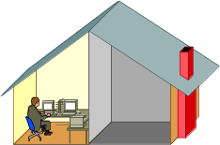

Komponenty moderného telefónneho systému
Long Distance and International Connections
IP
Central Office with Switches
Fiber
Local Loop
POTS and ADSL
Home Office with Corporate VPN including VoIP
Cellular Phone System
Notes:
Long distance in telecommunications, refers to telephone calls made outside a certain area, usually characterized by an area code outside of a local call area.
International Calls are made between different countries. The calls are processed by gateway exchanges (switches). The rates for these calls were expensive but are now cheaper due to advances in technology. Originally they were placed via operator. The calls were transmitted by cable, satellite, radio, and more recently, fiber optics and VOIP. IDD or ISD (International Direct Dialing) was introduced in the 1970's, so calls can be dialed without an operator.
A central office is the physical building used to house inside plant equipment including telephone switches, which make phone calls "work" in the sense of making connections and relaying the speech information.
In telephony, the local loop (also referred to as a subscriber line) is the physical link or circuit, that connects from the demarcation point of the customer premises to the edge of the carrier, or telecommunications service provider, network.
Plain old telephone service, or POTS, is the standard telephone service that remains the basic form of residential and small business telephone service nearly everywhere in the world, and was the only basic telephone service known to most people until the introduction of mobile phones.
Asymmetric Digital Subscriber Line (ADSL) is a form of DSL, a data communications technology that enables faster data transmission over copper telephone lines than a conventional voiceband modem can provide. It does this by utilizing frequencies that are normally not used by a voice telephone call, in particular, frequencies higher than normal human hearing.
Home office connectivity can be achieved over POTS and ADSL and can include VPN and VoIP technologies.
Mobile phones and the cellular phone system they operate under vary significantly from provider to provider, and nation to nation. However, all of them communicate through electromagnetic microwaves with a cell site base station, the antennas of which are usually mounted on a tower, pole, or building.

Slide 5
Tradičné telefónne služby
Služby PSTN (Public Switched Telephone Network) sa prakticky od svojho zavedenia nezmenili
  Obojsmerná plne duplexná cesta pre prenos hlasu
  Účastnícka signalizácia pomocou tónov
  Voľba účastníka
  Služby operátora – vyhľadanie čísla, medzimestské či medzinárodné hovory, konferenčné hovory...
  Napájanie účastníckych zariadení
Notes:
The Public Switched Telephone Network (PSTN) in North America and the Postal, and the Telephone and Telegraph (PTT) services in much of the rest of the world, carry analog voice over copper wires. This basic telephone service is often called POTS. In some places, POTS means the Post Office Telephone Service or Post Office Telephone System. However, as legislation removed telephone services from the control of national post offices, the term became more widely known as meaning “plain old telephone service.”
POTS remains the basic form of residential and small business telephone service nearly everywhere in the world. Until the introduction of mobile telephones, POTS was the only telephone service that most people knew. POTS has been available almost since the introduction of the telephone system in the late 19th century. Telephone service remained mostly unchanged to the average user since the middle of the 20th century, despite the introduction of electronic telephone exchanges into the PSTN and PTT.
While POTS provides a relatively limited feature set, low bandwidth and no mobile capabilities, it does provide (in most geographic areas) much greater reliability than any of the more “modern” telephone systems (wireless, cellular, VoIP, etc).
Listed here are some of the POTS services that are available.

Slide 6
Služby ISDN a T1/E1
ISDN: Sada štandardov pre sieť integrovaných služieb
  Dátové a hlasové služby na metalickom vedení medzi účastníkom a telefónnou ústredňou
  BRI: 2 B kanály a 1 D kanál pre signalizáciu
  PRI: 23 B kanálov (30 v Európe) a 1 D kanál pre signalizáciu
T1/E1 Carrier System
  Špecifikácie pre digitálny prenos medzi telefónnymi ústredňami, alebo medzi zákazníkom a telefónnou ústredňou
Medzi ústredňami sa využívajú ďalšie špecializované technológie
  Synchronous Digital Hierarchy (SDH)
  Synchronous Optical Networking (SONET)
Notes:
Recently, telcos began moving their digital networks closer to the customer premises. Generally, telcos offer digital transport services in one of two forms. Integrated Services Digital Network (ISDN) or T1/E1.
ISDN provides a digital loop from the exchange (or central office) to the customer premises. ISDN provides digital transmission over ordinary telephone copper wire as well as over other media. Conceptually, ISDN integrates both analog or voice traffic with digital data over the same network. Home and business users receive data at rates up to twice the rate of a modem connection. There are two levels of ISDN service. Both rates include a number of B-channels and a D-channel. Each B-channel carries data, voice, and other services at a rate of 64 kbps. Each D-channel carries control and signaling information:
Basic Rate Interface (BRI) is for home and small business use. BRI contains two B-channels and one D-channel.
Primary Rate Interface (PRI) is for larger users. PRI includes 23 B-channels in North America and Japan (30 in Europe) and one D-channel.
Service providers usually transmit PRI service through a T1 line in North America and an E1 line in Europe.
From a consumer point of view, and as a data connection service, DSL replaces ISDN.
In North America and Japan, transmission 1 (T1) carrier technology provides trunk lines between exchanges. Europe 1 (E1), is used in Europe. T1 and E1 lines are dedicated telephone connections supporting high data rates. Companies often use T1 for Internet traffic.

Slide 7
Služby digitálnych telefónnych sietí
Medzi služby digitálnych telefónnych sietí patria:
  Voice mail (odkazová schránka)
  Caller ID (identifikácia volajúceho)
  Call waiting (pridržanie hovoru)
  Reminder calls (upozornenia)
  (Three-way) conference calling (3-členné konferencie)
  Enhanced 911 (v USA)
  Centrex (služba virtuálnej pobočkovej ústredne)
  ... a mnohé ďalšie služby

Slide 8
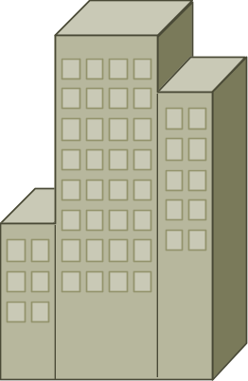



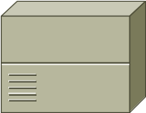
Osobitné siete pre hlas, video a dáta
San Jose Office
London Office
PBX
PBX
Tokyo Office
PBX
Notes:
Before advanced networking technologies allowed convergence, enterprises provisioned separate networks for voice, video, and data applications. In most cases, enterprises deployed voice, video, and data networks autonomously and operated them in isolation. Enterprises managed and implemented these networks with separate teams.
The separate networks encompass the enterprise local and wide-area networks. In simple terms, voice traffic used PBXs and data used routers. PBXs connected to dedicated leased lines. Data used a combination of leased lines, Frame Relay, and ATM.
The figure shows a typical deployment of these disparate networks. Video relied on special and very expensive leased line connections.

Slide 9





Konvergované siete pre hlas, video a dáta
PSTN
IP WAN
Notes:
It is widely accepted and acknowledged by the communications industry and industry analysts as a whole that IP will become the universal transport of the future. The rapid adoption and migration of vendors to the use of IP as a transport for data, voice, and video applications further endorses the transition to a converged networking paradigm.
This graphic shows an enterprise network converging over common IP transport. Using IP as the form of transport offers the enterprise significant statistical gains in bandwidth efficiency, lower overall bandwidth requirements, ease of management, and the ability to deploy new applications rapidly. There are fewer WAN facilities and fewer devices required to terminate those facilities. Enterprises add bandwidth incrementally as required and statistically share bandwidth between applications, adding efficiency and reducing complexity.

Slide 10
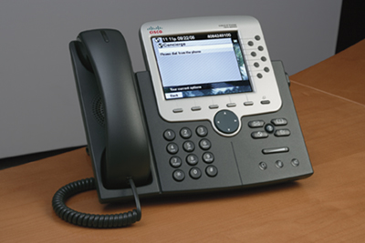
Výhody VoIP služby
Efektívnejšie využívanie disponibilného prenosového pásma a zariadení
Nižšie náklady na prenos hlasu
Konsolidovanie výdavkov na prevádzku siete
Zvýšenie produktivity vďaka pokročilým vlastnostiam zariadení IP telefónie
  IP telefóny môžu slúžiť ako komplexné komunikačné zariadenia
  Možnosti integrácie s najrôznejšími
  technológiami sú skoro neobmedzené
Klienti môžu byť softvéroví, mobilita
sa rieši existujúcimi mechanizmami
Notes:
More efficient use of bandwidth and equipment: Traditional telephony networks use a 64-kbps channel for every voice call. VoIP shares bandwidth among multiple logical connections.
Lower transmission costs: A substantial amount of equipment is needed to combine 64‑kbps channels into high-speed links for transport across the network. VoIP statistically multiplexes voice traffic alongside data traffic. This consolidation provides substantial savings on capital equipment and operations costs.
Consolidated network expenses: Instead of operating separate networks for voice and data, voice networks are converted to use the packet-switched architecture to create a single integrated communications network with a common switching and transmission system. The benefit is significant cost savings on network equipment and operations.
Improved employee productivity through features provided by IP telephony: IP phones are not only telephones; they are complete business communication devices. IP phones offer directory lookups and access to databases through Extensible Markup Language (XML) applications. These applications allow simple integration of telephony into any business application. For instance, employees can use the telephone to look up information about a customer who called in, search for inventory information, and enter orders. The employee can be notified of an issue (for example, a change of the shipment date), and with a single push of a button can call the customer about the change. In addition, software-based telephones or wireless telephones offer mobility to the telephone user.
Access to new communications devices: Packet technology can reach devices that are largely inaccessible to the modern time-division multiplexing (TDM) infrastructures. Examples of such devices are computers, wireless devices, household appliances, personal digital assistants (PDAs), and cable set-top boxes. Intelligent access to such devices enables companies and service providers to increase the volume of communications that companies deliver, the breadth of services that companies offer, and the number of subscribers that companies serve. Packet technology, therefore, enables companies to market new devices, including videotelephones, multimedia terminals, and advanced IP phones.

Slide 11
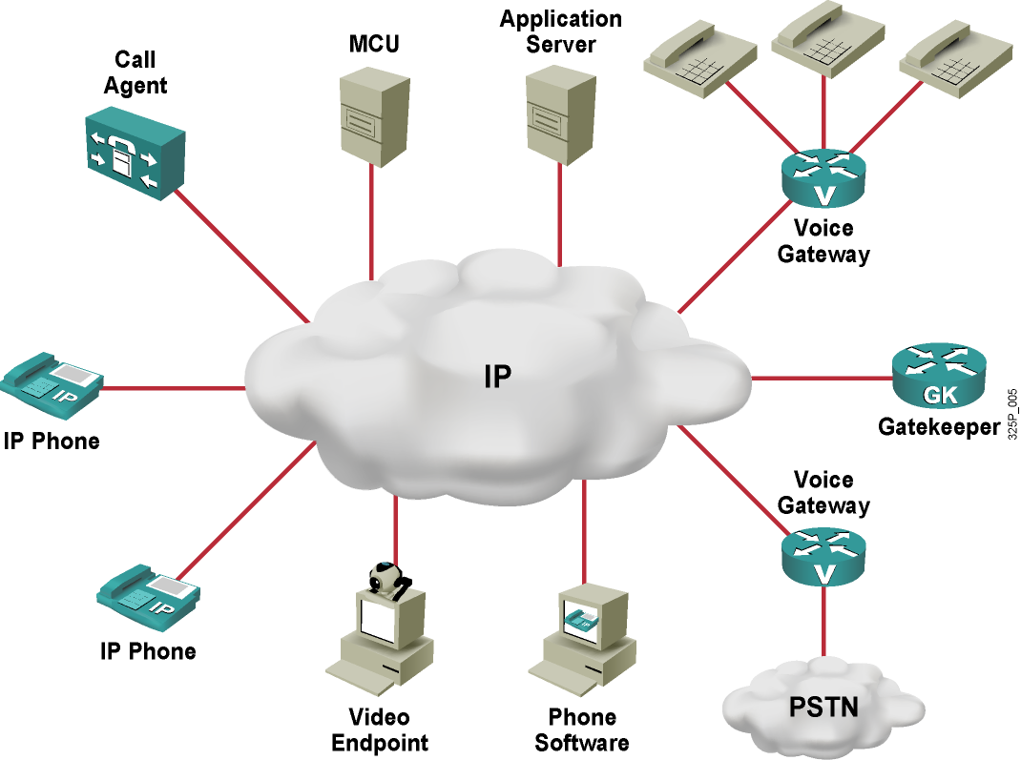
Komponenty VoIP služby
Notes:
A VoIP network has several components:
Telephones: Telephones provide telephony features to users. Telephones can be IP phones, software-based telephones operated on PCs, or traditional telephones (analog or ISDN).
Gateways: Gateways interconnect the VoIP network with traditional telephony devices. These can be analog or ISDN telephones, faxes, circuit-switched PBX systems, or public switched telephone network (PSTN) switches.
Multipoint control units: A multipoint control unit (MCU) is required for conferences. If more than two parties are involved in a call, all members of the conference send their media to the MCU. The MCU mixes the media and then sends the media to all participants.
Application servers: Application servers provide XML-based services to IP phones. IP phone users have access to directories and databases through XML applications.
Gatekeepers: Gatekeepers provide Call Admission Control (CAC) to prevent the network from being over subscribed. As well, CAC translates telephone numbers or names to IP addresses for call routing in an H.323 network.
Call agents: Call agents provide call control, CAC, bandwidth control, and address translation services to IP phones or Media Gateway Control Protocol (MGCP) gateways.
Video endpoints: Video endpoints provide video telephony features to users. As with audio-only calls, video calls need a multipoint control unit for conferences. For videoconferences, the multipoint control unit has to be capable of mixing video and audio streams.

Slide 12
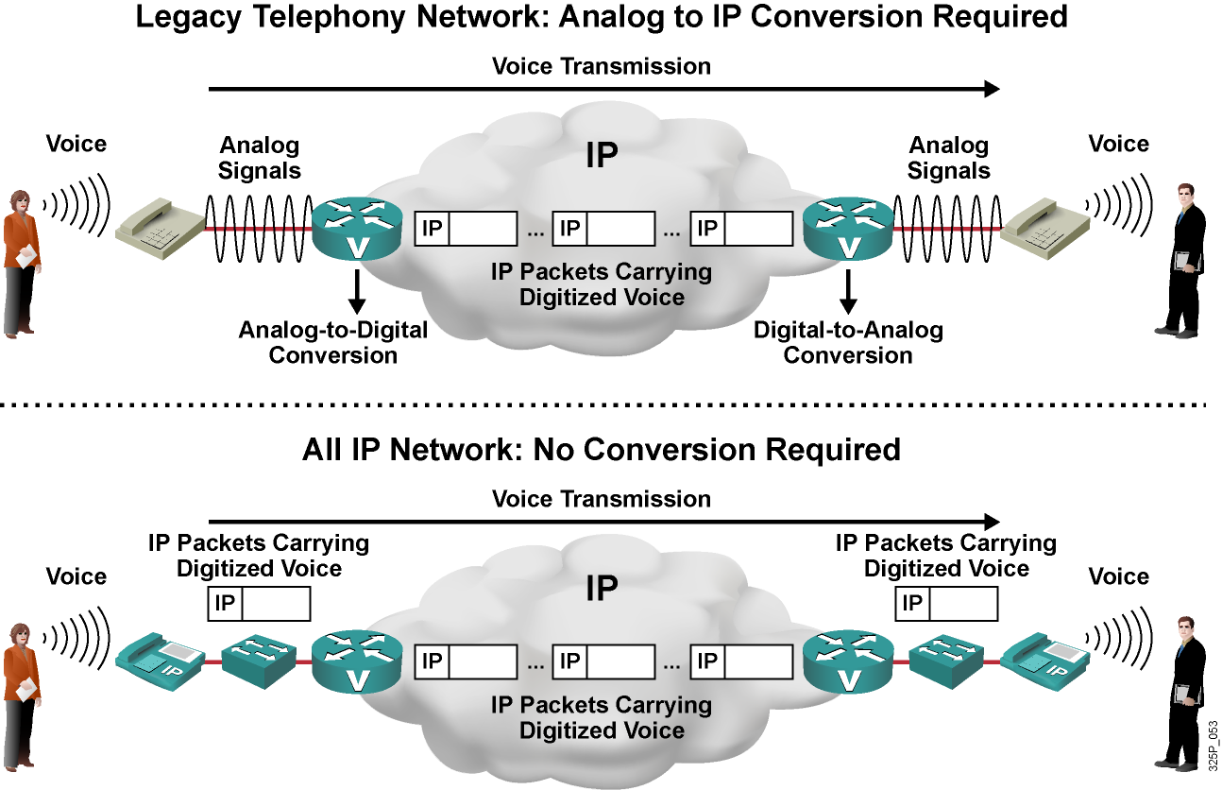
Koexistencia klasických a VoIP služieb
Notes:
Once a company decides to migrate to VoIP, the company can choose an all-IP option or retain all or part of its analog networks.
Maintaining analog networks requires analog-to-IP conversion.
In a VoIP network, some functions rely on digital signal processors (DSPs). DSPs convert analog voice signals into digital format and vice versa. They also provide functions such as voice compression, transcoding (changing between different formats of digitized voice), and conferencing. DSPs are hardware components that are located on voice modules inside gateways.

Slide 13
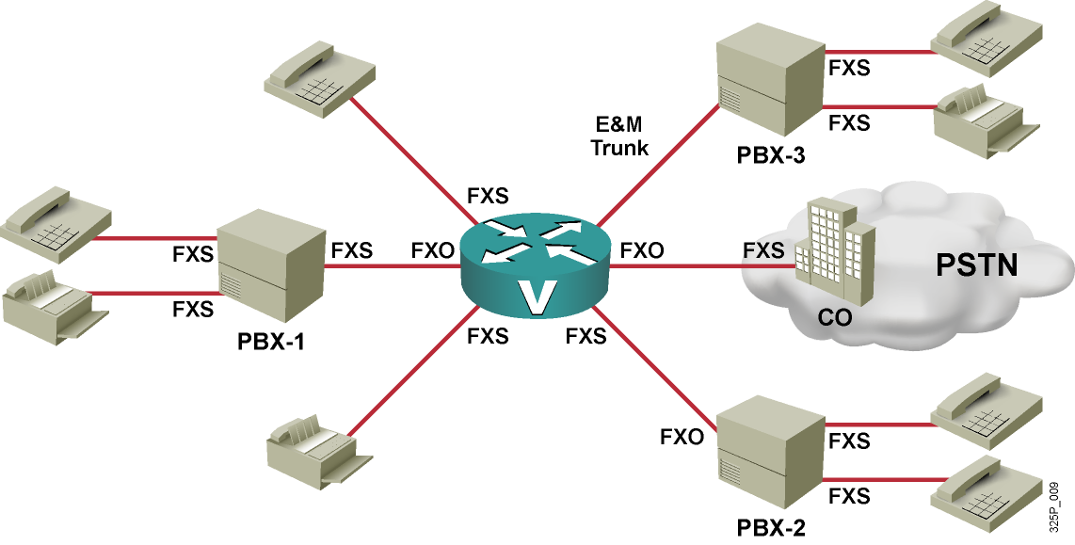
Rozhrania v klasickej analógovej telefónii
Typ analógového rozhrania | Skratka | Popis
Foreign Exchange Station | FXS | Rozhranie na strane ústredne
Foreign Exchange Office | FXO | Rozhranie na účastníckom zariadení
Earth and Magneto | E&M | Medziústredňové rozhrania
Notes:
Gateways use different types of interfaces to connect to analog devices, such as telephones, fax machines, or PBX or PSTN switches. Analog interfaces that are used at the gateways include these three types:
Foreign Exchange Station (FXS): FXS is a telephone interface that provides battery power, sends dial tone, and generates ringing voltage. A standard telephone plugs into such an interface to receive telephone service. A telephone exchange is an example of an FXS. In VoIP implementations, the FXS interface connects to analog end systems; the analog end system uses the Foreign Exchange Office (FXO) interface on the end system side. The router FXS interface behaves like a PSTN or a PBX by serving telephones, answering machines, or fax machines with line power, ring voltage, and dial tones. If a PBX uses an FXO interface, it can also connect to a router FXS interface. In this case, the PBX acts like a telephone.
FXO: An FXO is a telephone interface that connects to the PSTN. FXO generates the on-hook and off-hook indicators that are used to signal a loop closure at the FXO’s end of the circuit. In VoIP implementations, the FXO interface connects to the PSTN or a PBX; both PSTN and PBX use the FXS interface on their side. The router FXO interface behaves like a telephone, obtaining line power, ring voltage, and dial tones from the other side of the interface. As mentioned, a PBX can also use an FXO interface toward the router (which will then use an FXS interface) if the PBX takes the role of the telephone.
Ear and Mouth (E&M): The E&M interface provides signaling for analog trunks. Analog trunks interconnect two PBX-style devices, such as any combination of a gateway (acting as a PBX), a PBX, and a PSTN switch. E&M is often defined as “ear and mouth,” but it derives from the term “earth and magneto.” “Earth” represents the electrical ground, and “magneto” represents the electromagnet used to generate tones.

Slide 14
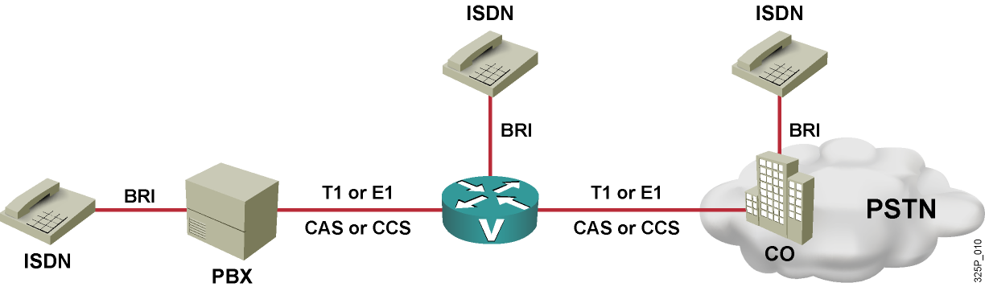
Digitálne hlasové rozhrania
Rozhranie | Počet hlasových kanálov (64 kbps) | Signalizácia | Réžia na rámcovanie | Celkový objem prenosu
BRI | 2 | 1 kanál (16 kbps) | 48 kbps | 192 kbps
T1 CAS | 24 (nie plných 64 kbps) | in-band (priamo v hlasových kanáloch) | 8 kbps | 1544 kbps
T1 CCS | 23 | 1 kanál (64 kbps) | 8 kbps | 1544 kbps
E1 CAS | 30 | 64 kbps | 64 kbps | 2048 kbps
E1 CCS | 30 | 1 kanál (64 kbps) | 64 kbps | 2048 kbps
Notes:
Gateways can use digital interfaces to connect to voice equipment. From a hardware perspective, there are BRIs and T1 and E1 interfaces available. All of the interfaces use TDM to support multiple logical channels.
T1 and E1 interfaces can use either channel associated signaling (CAS) or common channel signaling (CCS), while a BRI always uses CCS. ISDN PRIs use T1 or E1 CCS.
This graphic shows a router that serves an ISDN telephone using a BRI voice interface. In addition, the router has two T1 or E1 lines: one to a PBX and one to the PSTN. Depending on the interface type (T1 or E1) and the signaling method (CAS or CCS), a maximum of 23, 24, or 30 voice channels are available on these trunks. The PSTN and the PBX also serve ISDN telephones through BRI connections.
The table shows the number of voice channels, the signaling bandwidth, total bandwidth, and framing overhead for all available interface and signaling options.

Slide 15
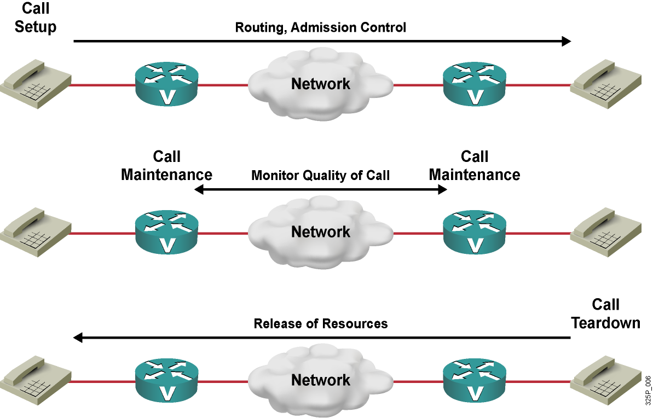
Zostavenie hovoru vo VoIP
Riadiace zariadenia určia cestu pre zostavenie hovoru na základe svojej konfigurácie pre smerovanie hovorov
Následne overia, či je dostupné dostatočné prenosové pásmo pre hovor daného typu
  Ak je pásmo dostupné, pokúsia sa zostaviť hovor (Call Admission Control)
  Ak pásmo dostupné nie je, vrátia signál obsadeného kanála
Notes:
Although different protocols address call control in different ways, all protocols provide a common set of services. There are three components of basic call control: call setup, call maintenance, and call tear down.
Call setup checks the call-routing configuration to determine the destination of a call. The configuration specifies the bandwidth requirements for the call. Knowing the bandwidth requirements, CAC determines whether sufficient bandwidth is available to support the call. If bandwidth is available, call setup generates a setup message and sends the message to the destination. If bandwidth is not available, call setup presents the call initiator with a busy signal. Different call control protocols, such as H.323, MGCP, and session initiation protocol (SIP), define different sets of messages that devices exchange during setup. However, all of the messages consult the same basic information:
The IP addresses of the two devices that will exchange VoIP
The User Datagram Protocol (UDP) port numbers that will be used for the Real-Time Transport Protocol (RTP) streams
The format (for example, the compression algorithm) used for the digitized voice

Slide 16
Udržiavanie hovoru vo VoIP
Počas hovoru je možné sledovať prenosové charakteristiky
  Straty paketov
  Nerovnomernosť oneskorenia (jitter)
  Oneskorenie
Hovor s príliš nízkou kvalitou môže byť ukončený
Notes:
Call maintenance tracks packet count, packet loss, jitter, and delay during the call. Information passes to the voice-enabled devices to determine whether connection quality is good or has deteriorated to the point where the gateway will drop the call.

Slide 17
Ukončenie (rozpad) spojenia vo VoIP
Zariadenia sú informované o ukončení hovoru a uvoľnia obsadené prostriedky
Tieto prostriedky sú k dispozícii pre iné volania
Notes:
Call teardown notifies voice-enabled devices to free resources and make them available for other calls when either side terminates a call.

Slide 18
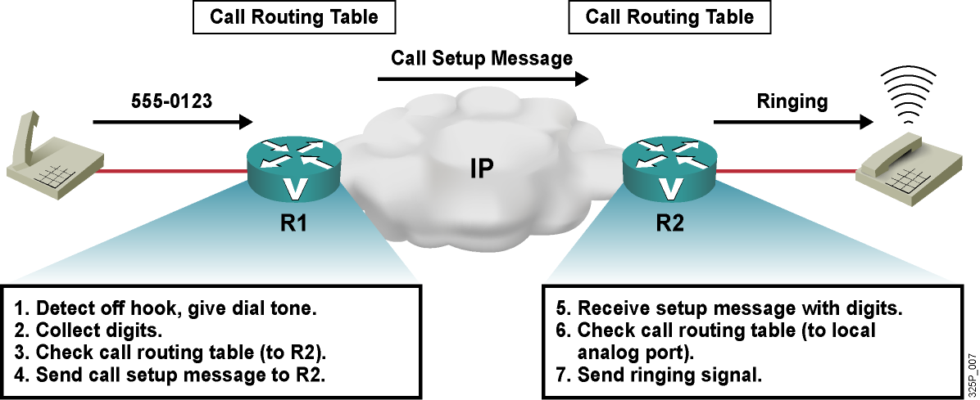
Distribuované riadenie hovorov
Notes:
With distributed call control, the devices perform the call setup, call maintenance, and call teardown without telephone company involvement:
Process dialed digits and route the call:
After detecting a service request (the telephone is taken off the hook), the first gateway (R1) plays a dial tone.
Next, R1 collects the digits that the caller dials.
R1 then looks up the called number in the R1 local call-routing table. According to the call routing table, the called number uses the second gateway (R2).
R1 now enters the first stage of a call, call setup, by sending the appropriate message to R2.
R2 receives the call setup message from R1.
R2 then looks up the called number in its local call routing table. According to the call routing table, the called number uses a local voice port.
R2 sends the call to the local voice port by applying the ring voltage.
In this example, R1 made a local decision to send the call setup message to R2 based on the call routing table of R1. R2 again made a local decision (using the R2 call routing table) that the called device could be reached on a certain physical port.
Supervise the call: During the call, R1 and R2 both monitor the quality of the call. In the distributed call control model, if one of the gateways detects that the quality is no longer acceptable, the gateway locally terminates the call. Supervision of the call occurs during the second stage of the call, call maintenance.
Terminate the call: If the caller that is connected to R1 finishes the call, R1 informs R2 of the termination. In the distributed call control model, the gateway initiates the third stage of a call, call teardown. The gateway terminates the call and releases the resources that were used by the call.
This graphic shows how each gateway uses distributed call control to make its own autonomous decisions and not depend on the availability of another (centralized) device to provide call routing services. Because each gateway has its own intelligence, there is no single point of failure. However, each gateway needs to have a local call routing table, which needs manual configuration. This need makes administration of the distributed call control model less scalable.

Slide 19
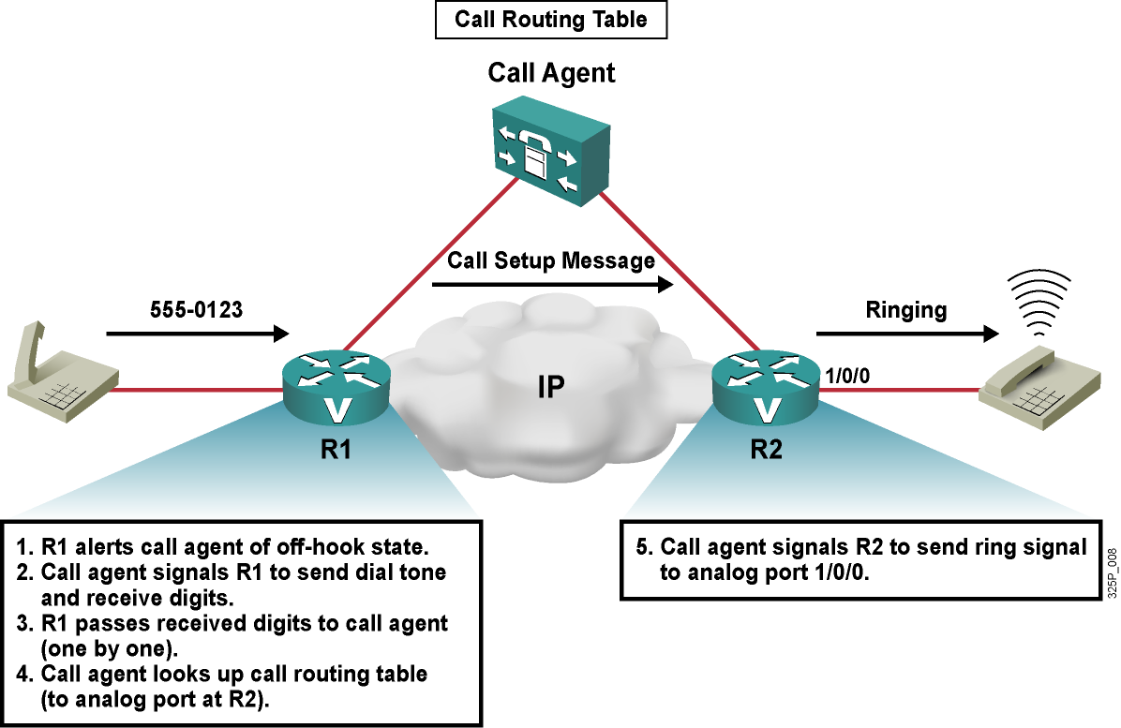
Centralizované riadenie hovorov
Notes:
This graphic shows an environment where a single component in the network, a call agent, handles call control. Such centralized call control applies when the voice-capable device does not support call control on its own but uses a call agent. In this example, both voice gateways have the MGCP protocol enabled. With MGCP call control enabled, the gateways use the call agent to perform these functions:
Process dialed digits and route the call:
1. After detecting a service request (the telephone is taken off the hook), the first gateway (R1) informs its call agent of the request.
2. The call agent tells R1 to play a dial tone and receive the digits that the user dials.
3. R1 passes each received digit (one by one) to the call agent.
4. The call agent looks up the called number in the agent’s call routing table. According to the call routing table, the requested telephone number is reached using the second gateway (R2). This call agent also controls R2 and, therefore, knows which telephone numbers R2 can reach. Therefore, the call agent knows which port at R2 the call has to be routed to.
5. The call agent now sends a message to R2 requesting that the call pass to a certain port (the port that connects to the destination telephone number).
Call routing decisions, which gateway to use after receiving the call at R1, and how to pass the call on at that next gateway (R2), are made by the call agent. This is an example of the centralized call control model, where all call routing intelligence (required for the first stage of a call, the call setup) is at the call agent. The call agent then instructs the gateways how to handle the call. Therefore, only the call agent has a call routing table.
Supervise the call: During the call, R1 and R2 both monitor the quality of the call. In the centralized call control model, if one of the gateways detects that the quality is no longer adequate, it will pass that information to the call agent. The call agent then terminates the call. Supervision of the call occurs during the second stage of a call, call maintenance.
Terminate the call: If the caller that is connected to R1 finishes the call, R1 informs the call agent of the termination. The call agent notifies both gateways to terminate the VoIP call and release the resources that were used by the call. In the centralized call control model, the call agent initiates the third stage of a call, call teardown.
As illustrated in the example, with centralized call control, the gateways do not make any local decisions. Instead, they inform the call agent about events (such as incoming or dropped calls). Only the call agent makes call routing decisions, and the gateways depend on the availability of their call agent. Availability of the call agent is critical, because the call agent is a single point of failure. However, only the call agent needs to have a call routing table. Therefore, administration of the centralized call control model is more scalable.
Centralized call control allows an external device (call agent) to handle signaling and call processing, leaving the gateway to translate audio signals into voice packets after call setup. After the call is set up, the voice path runs directly between the two gateways and does not involve the call agent. The difference between distributed and centralized call control applies only to signaling and never to the media exchange, which always goes on directly between the two gateways.

Slide 20
Princípy digitalizácie hlasu

Slide 21
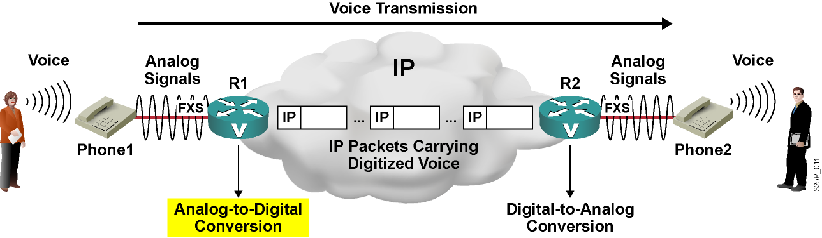
Analógovo-digitálna konverzia hlasu
Krok 1: Vzorkovanie signálu
Krok 2: Kvantizácia vzoriek
Krok 3: Kompresia vzoriek
Krok 4: Kódovanie vzoriek
Notes:
Sampling is the technique that is used to digitize analog information. For example, producers digitize music for CDs by sampling live sound at frequent intervals and then digitizing each sample. DSPs have a similar role in digitizing voice signals in voice-enabled routers.
This graphic illustrates how voice-enabled routers convert analog voice signals to digital format for encapsulation in IP packets and transport over IP networks.
In the example, a call is being made from an analog telephone (Phone1) connected to a router (R1) to an analog telephone (Phone2) connected to another router (R2). The two routers connect to an IP network. The user at Phone1 speaks into the microphone of the telephone, and the telephone sends an analog signal to the FXS port of router R1. Router R1 converts the received analog signal to a digital signal and encapsulates the bits into IP packets. The IP network carries the IP packets to router R2.
DSPs on the voice interface cards of the voice-enabled routers perform the analog-to-digital conversion. Figure 2.2.1.2 summarizes the steps:
Sampling: The DSP periodically samples the analog signal. The output of the sampling is a pulse amplitude modulation (PAM) signal measured in volts.
Quantization: The DSP matches the PAM signal to a segmented scale. This scale measures the amplitude (height or voltage) of the PAM signal.
Compression: The DSP compresses voice samples to reduce bandwidth requirements.

Slide 22
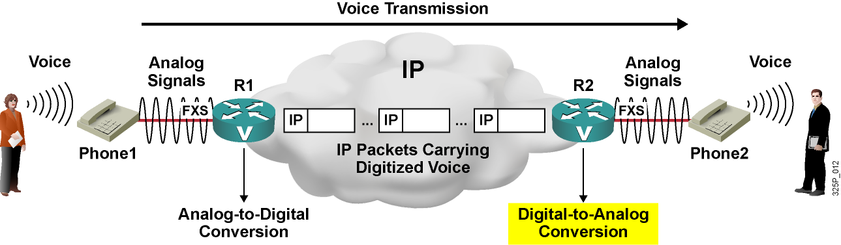
Digitálno-analógová konverzia hlasu
Krok 1: Dekódovanie vzoriek
Krok 2: Dekompresia vzoriek
Krok 3: Reprezentácia vzoriek napäťovými úrovňami
Krok 4: Rekonštrukcia analógového signálu z napäťových úrovní
Notes:
When a router receives voice in digital format, it has to convert it back to analog signals before sending it out to analog voice interfaces.
This graphic illustrates a call from an analog telephone (Phone1) connected to a router (R1) to an analog telephone (Phone2) connected to another router (R2). The two routers connect to an IP network. When router R2 receives the IP packets carrying digitized voice, the router converts the packets back to analog signals. The analog signals go to Phone2 and play through the speaker of the telephone; the user at Phone2 hears the original speech.
The digital-to-analog process is the reverse of the analog-to-digital conversion. DSPs on the voice interface cards of the voice-enabled routers convert digital signals to analog signals. The process includes these steps:
Decompression: Any compressed voice samples are first decompressed. This is an optional step in converting analog signals.
Decoding: The DSPs in the voice interface card decode the digital voice samples to the amplitude value of the samples and then rebuild a PAM signal of the original amplitude.
Reconstruction of the analog signal: The DSP passes the PAM signal through a properly designed filter that reconstructs the original analog waveform from the digitally coded counterpart.

Slide 23
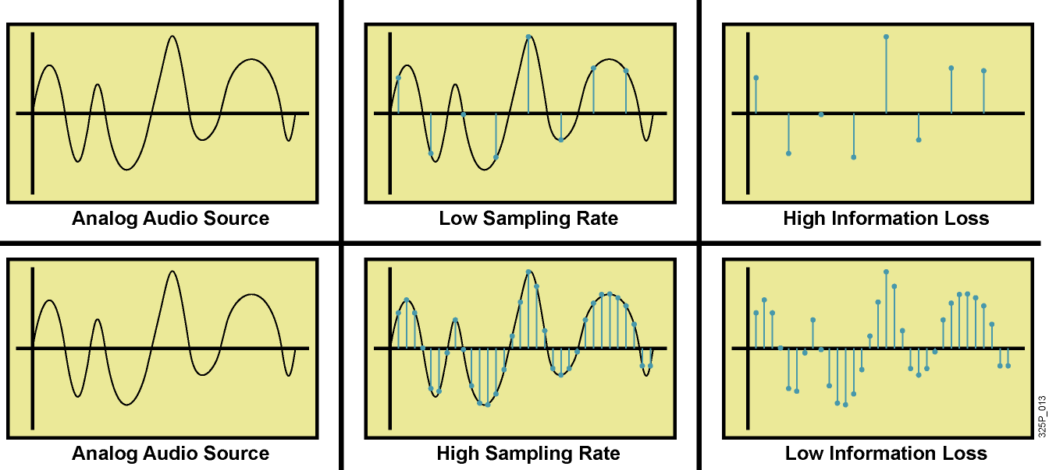
Vzorkovacia frekvencia
Vzorkovacia frekvencia pri vzorkovaní priamo ovplyvňuje vernosť digitalizovaného signálu
Podľa Shannona, Nyquista a Kotelnikova, vzorkovacia frekvencia musí byť aspoň dvojnásobkom maximálnej frekvencie, ktorú chceme preniesť
Notes:
When a DSP converts an analog signal to digital form, the DSP samples the analog signal first. The sampling rate impacts the quality of the digitized signal. If the sampling rate is too low, the DSP processes too little information and the resulting quality is degraded. If the sampling rate is higher than needed, unnecessary bandwidth is consumed that could be used for additional calls. This is called oversampling, and should also be avoided.
The Nyquist Theorem can be used to determine an appropriate sampling rate.
The Nyquist theorem is the basis of analog-to-digital conversion. In simple terms, the Nyquist theorem tells us that reconstruction of a signal from the signal samples is possible if the sampling frequency is greater than twice the signal bandwidth. In practical terms, reconstruction is neither perfect nor exact. Engineers select sampling rates to meet the practical requirements of specific applications.
The example shows two sampling rates. In the first, the sampling rate is too low and the reconstructed information is imprecise. Practical reconstruction is impossible. In the second situation, a higher sampling rate is used, and the resulting PAM signals represent the original waveform; this situation allows for practical reconstruction.
The Nyquist theorem predicts how a DSP works; when the DSP samples a signal instantaneously at regular intervals and at a rate of at least twice the highest channel frequency, then the samples contain sufficient information to allow an accurate reconstruction of the signal at the receiver.

Slide 24
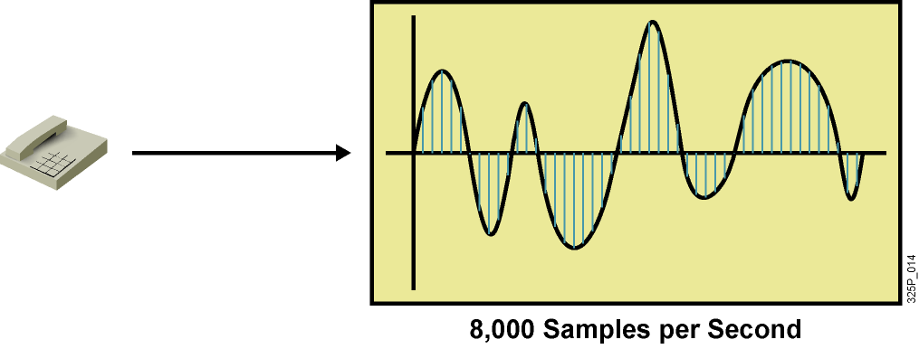
Vzorkovacia frekvencia v telefónii
Ľudská reč je v rozsahu 200–9000 Hz
Ľudské ucho počuje v rozsahu 20–20 000 Hz.
Tradičné telefónne systémy boli navrhované pre rozsah 300–3400 Hz
  V tomto pásme sa nachádza podstatná časť frekvenčného spektra hlasu
Vzorkovacia frekvencia bola preto stanovená na úroveň 8000 Hz
Notes:
This example illustrates how engineers arrived at a rate of 8000 samples per second for telephony applications.
Although the human ear can sense sounds from 20 to 20,000 Hz, and speech encompasses sounds from about 200 to 9000 Hz, the telephone channels we use operate at about 300 to 3400 Hz. This economical range carries enough fidelity to allow callers to identify who the party at the other end of the connection is and to sense the other party’s mood.
To allow capturing of higher-frequency sounds that the telephone channel can deliver, the highest frequency for voice was set to 4000 Hz. Using the Nyquist theorem, the sampling rate results in 8000 samples per second (twice as high as the highest frequency); that is, one sample every 125 ms.

Slide 25
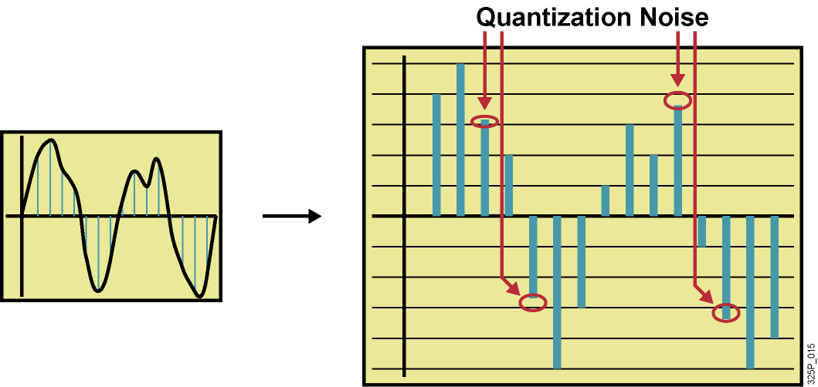
Kvantizácia
Kvantizácia je priradenie vzorky istej dopredu dohodnutej diskrétnej úrovni
V telefónii sa využíva 8-bitové vzorkovanie (256 úrovní)
Vzorky sa zaokrúhľujú k najbližšej úrovni
Zaokrúhľovanie spôsobuje skreslenie (kvantizačný šum)
Notes:
After the samples are collected, they are still in analog format. The next step in digitizing the voice waveforms is to take these PAM amplitudes and assign them a number, which can then be transmitted in binary form. The process of assigning a number to an amplitude is called quantization.
Quantization is the process of selecting those binary numbers to represent the voltage level of each sample (the PAM value). In a sense, DSPs use quantization to approximate analog sounds to the nearest binary value that is available. The DSP must select a whole number that is closest to the signal level the DSP is reading at the instant the signal is sampled. The PAM values are rounded up or down to the step that is closest to the original analog signal. The difference between the original analog signal and the quantization level assigned is called quantization error or quantization noise. This difference is the source of distortion in digital transmission systems.
Telephony applications usually use 8-bit quantization. DSPs represent all possible values of the analog waveform with 256 distinct voltage values each represented by an 8-bit binary number. These approximations are not an exact duplication of the analog waveform and contain quantization errors (noise). By comparison, compact discs use 16-bit quantization that allows for 65,536 distinct voltage levels. Although 8-bit quantization is crude and introduces substantial quantization noise into the signal, the result is still more than adequate to represent human speech in telephony applications. Over-sampling helps reduce quantization noise.
In this example, the x-axis of the chart is time and the y-axis of the chart is the voltage value (PAM). The example shows quantization noise distortion at all signals that do not exactly match one of the steps.

Slide 26
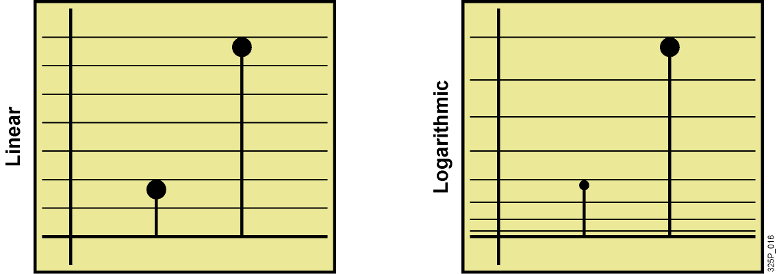
Kvantizačné techniky
Lineárna kvantizácia
  Nižší odstup signálu od šumu pre signály so slabou úrovňou (horšia kvalita)
  Vyšší odstup signálu od šumy pre signály s vysokou úrovňou (lepšia kvalita)
Logaritmická kvantizácia
  Cieľom je poskytnúť čo možno konštantnú úroveň odstupu signálu od šumu
  Pre slabý signál jemnejšia mierka, pre silný signál hrubšia
  Viac zodpovedá logaritmickým vlastnostiam ľudského ucha
Notes:
An unfortunate reality of quantization is that quantization distortion increases at lower frequencies because the signal is using a smaller portion of the available dynamic range. This use produces errors that are proportionally large relative to the signal. To avoid these signal-to-noise ratio (SNR) issues, engineers use a logarithmic scale to provide better granularity for smaller signals, resulting in a more uniform SNR for all signals.
Note: The higher the SNR, the better the voice quality.
The graphic shows why quantization noise is a problem when a linear scale is used. As illustrated in the figure, a linear scale results in very a low SNR on small signals and a high SNR on large signals. Logarithmic segmentation corresponds closely to the logarithmic behavior of the human ear. To avoid a low SNR, logarithmic quantization methods are common. This example shows methods that are used for voice signals in the telephony environment.

Slide 27
Logaritmická kompresia
Kompresia a dekompresia zvuku v nelineárnej mierke sa niekedy označuje pojmom companding (compression and expanding)
Pre telefóniu existujú dve hlavné logaritmické kompresie
  μ-zákon (Mu-law), používaný v Kanade, USA a Japonsku
  A-zákon (A-law), používaný v ostatných krajinách
Obe kompresie využívajú kvázilogaritmickú mierku
  Logaritmické veľkosti segmentov
  Lineárna veľkosť kroku v segmente
Obe kompresie majú 8 kladných a 8 záporných segmentov, na každý segment je16 krokov
Medzinárodný hovor musí prebiehať kompresiou podľa A-zákona. Konverzia z μ na A je zodpovednosťou krajiny, ktorá používa μ
Pozor, slovo kompresia sa v tomto význame nepoužíva vo význame zmenšenia objemu prenášaných dát
Notes:
Companding refers to the process of first compressing an analog signal at the source, and then expanding this signal back to its original size when it reaches its destination. The term companding comes from combining the two terms, compressing and expanding, into one word. A compander compresses input analog signal samples into logarithmic segments. The compander then quantizes and codes each segment using uniform quantization.
Bell Systems defined the mu-law method of quantization that is used in the digital telecommunication systems of North America and Japan. This method of quantization was adopted as the A-law algorithm for use in Europe and much of the rest of the world. Following the idea of allowing smaller step functions at lower amplitudes rather than at higher amplitudes, the mu-law and a-law provide a quasi-logarithmic scale. The voltage range has 16 segments (0 to 7 positive and 0 to 7 negative). Each segment has 16 steps for a total of 256 point on the scale. Starting with segment 0, which is closest to zero amplitude, the segments grow bigger toward the maximum amplitudes and the size of the steps increases. Within a segment, however, the size of the steps is linear.
The result of using mu-law and A-law is a more accurate value for smaller amplitudes and a uniform signal-to-noise quantization ratio (SQR) across the input range.
The ITU Telecommunication Standardization Sector (ITU-T) standards for companding include the A-law and mu-law in recommendation G.711.

Slide 28
Kódovanie kvantizovaných vzoriek
Kódovanie je spôsob zápisu dát získaných vzorkovaním
a kvantizáciou do kódových slov (čísel)
V telefónii existujú mnohé kódovacie schémy
Pulse Code Modulation (PCM)
  Priama digitálna reprezentácia analógového signálu
  Signál sa vzorkuje pravidelne
  Vzorkovacia frekvencia je 8 kHz
  Základ pre telefónnu digitálnu hierarchiu
Adaptive Differential Pulse Code Modulation (ADPCM)
  Nahrádza PCM
  Prenáša iba rozdiely medzi susednými vzorkami
Notes:
Pulse-code modulation (PCM) is a digital representation of an analog signal where the magnitude of the signal is sampled regularly at uniform intervals, then quantized to a series of symbols in a digital (usually binary) code.
The basic PCM technique is to use a coder-decoder (codec) to sample the amplitude of a voice signal 8000 times per second and then store the amplitude value as 8 bits of data. There is a formula to this storage procedure:
8000 samples/second × 8 bits/sample = 64,000 bits/sec
The result is the basis for the entire telephone system digital hierarchy.
Adaptive Differential Pulse Code Modulation (ADPCM) replaces PCM. ADPCM uses a special encoding technique that reduces the data that is required to store each sample, transmitting only the difference between one sample and the next. An adaptive predictor algorithm predicts in advance how the signal will change. The prediction is usually very accurate. As samples vary, the predictor rapidly adapts to the changes. ADPCM provides 48 voice channels on a T1 line, which benefits customers who use such lines to interconnect their remote offices or connect their internal phone systems to the phone company switches.

Slide 29
Kódovanie kvantizovaných vzoriek
Základným formátom pre kódovanie kvantizovaných vzoriek v telefónii je ITU-T G.711
Podľa G.711 je každá vzorka po kvantizácii zapísaná pomocou 8 bitov:
  Znamienkový bit
  Tri segmentové bity
  Štyri úrovňové bity na segment
Prenosové pásmo pre jeden hovor pri G.711 v jednom smere je 64 kbps (8000 vzoriek x 8 bitov na vzorku)
Telefónne siete s prepínaním okruhov využívajú TDM na prenos viacerých 64 kbps kanálov (tzv. DS0) po jednom fyzickom médiu
Notes:
Digital voice samples are represented by 8 bits per sample. Each sample is encoded in the following way:
One polarity bit: Indicates positive or negative signals
Three segment bits: Identify the logarithmically sized segment number (0–7)
Four step bits: Identify the linear step within a segment
Because telephony sampling takes 8000 samples per second, the bandwidth that is needed per call is 64 kbps. This bandwidth need is why traditional circuit-switched telephony networks use time-division-multiplexed lines, combining multiple channels of 64 kbps each (digital signal level 0 [DS-0]) in a single physical interface.

Slide 30
Charakteristiky bežných hlasových kodekov
Štandard ITU-T | Kodek | Bitová rýchlosť (kbps)
G.711 | PCM | 64
G.726 | ADPCM | 16, 24, 32
G.728 | LDCELP (Low Delay CELP) | 16
G.729 | CS-ACELP | 8
G.729A | CS-ACELP, nižšia výpočtová zložitosť | 8
Notes:
The table shows the most popular coding techniques by their bit rates that are standardized for telephony by the ITU-T in its G-series recommendations:
G.711—Describes the 64-Kbit/sec PCM voice coding technique. In G.711, encoded voice is already in the correct format for digital voice delivery in the PSTN or through PBXs. The ITU-T standardized the earlier implementation of the mu-law and A-law under this one recommendation.
G.726—Describes ADPCM coding at 40, 32, 24, and 16 Kbps. ADPCM-encoded voice can be interchanged between packet voice, PSTN, and PBX networks if the PBX networks are configured to support ADPCM.
G.728—Describes a 16-Kbps low-delay variation of code excited linear prediction (CELP) voice compression. CELP voice coding must be translated into a public telephony format for delivery to or through the PSTN.
G.729—Describes CELP compression that codes voice into an 8-Kbps streams, or conjugate structure algebraic code excited linear prediction (CS-ACELP).
G.729A—Describes audio data compression algorithm for voice that compresses voice audio in sections of 10 ms. G.729A is compatible with G.729 (which also uses CS-ACELP), but G.729A requires less computation. This lower complexity does have the disadvantage of marginally worsening speech quality. G.729 and G.729 Annex A differ mainly in computational complexity; both provide speech quality similar to 32-Kbps ADPCM.

Slide 31
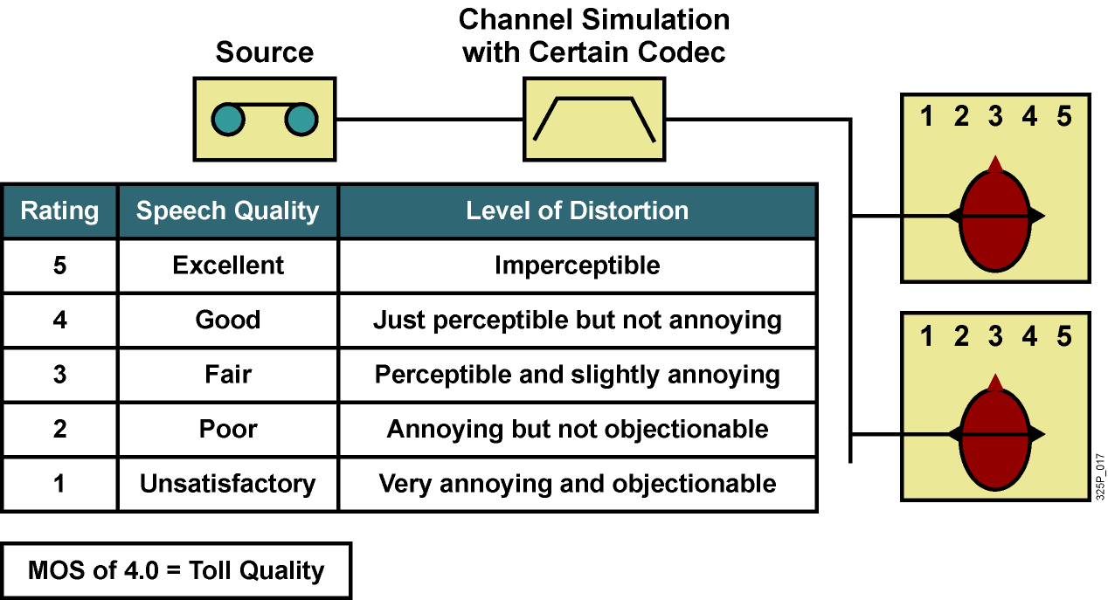
Hodnotenie kvality – Mean Opinion Score
Základným hodnotením kvality prenosu hlasu v telefónnej službe je tzv. MOS skóre
  Metodika vyhodnocovania je odporúčaná v ITU-T P.800
Notes:
The most important characteristics of a codec are the required bandwidth for the procedure and the quality degradation caused by the analog-to-digital conversion and compression.
The Mean Opinion Score (MOS) provides a numerical indication of the perceived quality of received media after compression and/or transmission. The MOS is expressed as a single number in the range 1 to 5, where 1 is lowest perceived quality, and 5 is the highest perceived quality.
The mean opinion score (MOS) is a system of grading the voice quality of the telephone connection that uses codec. The MOS is a statistical measurement of voice quality that is based on the judgment of several subscribers. Because MOS is graded by humans the score is subjective. The range of the MOS is 1 to 5, where 5 is direct conversation. The table lists the five ratings.
Some codecs and their voice quality ratings:
G.711, PCM – 4.1
G.726, ADPCM – 3.85 (with 32 kbps)
G.728, LDCELP – 3.61
G.729, CS-ACELP – 3.92
G.729A, CS-ACELP – 3.9

Slide 32

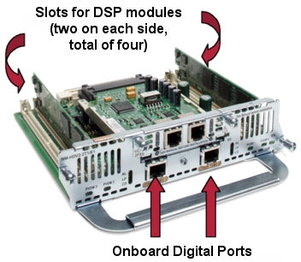
DSP – srdce digitalizačného systému hlasu
DSP je špecializovaný procesor pre spracovanie
signálov v digitálnej oblasti
DSP majú veľké využitie v telefónii
  Ukončenie digitálneho prenosového reťazca
    Pracuje ako kompandér,
    A/D a D/A prevodník
    Poskytuje funkcie pre potlačenie
    ozveny, VAD, CNG, vyrovnávanie
    oneskorenia a ďalšie funkcie
  Konferenčné hovory
    Zmiešavanie vstupných tokov
    od viacerých účastníkov
  Transkódovanie
    Prevod medzi rôznymi
    nekompatibilnými kodekmi
DSP modul
Voice Network Module
Notes:
A digital signal processor (DSP) is a specialized processor that is used for telephony applications:
Voice termination: DSPs terminate calls to the gateway that have been received from or placed to traditional voice interfaces. These interfaces can be digital or analog interfaces. For example, when an analog telephone places a call to the PSTN (over a digital trunk) or to a VoIP device, a DSP resource is used to accommodate this call. The DSP converts the analog signal to digital (and vice versa for the reverse direction) and provides echo cancellation, compression, voice activity detection (VAD), comfort noise generation (CNG), jitter removal, and other similar functions.
Conferencing: In audio conferencing, DSPs mix voice streams from multiple participants into a single conference call stream. All participants send their audio to the conference bridge (that is, the DSP), where the streams are mixed and then played back to all participants.
Transcoding: DSP takes a voice stream of one codec type and converts it to another codec type. For example, transcoding takes a voice stream from a G.711 codec and transcodes the stream in real time to a G.729 codec stream.

Slide 33
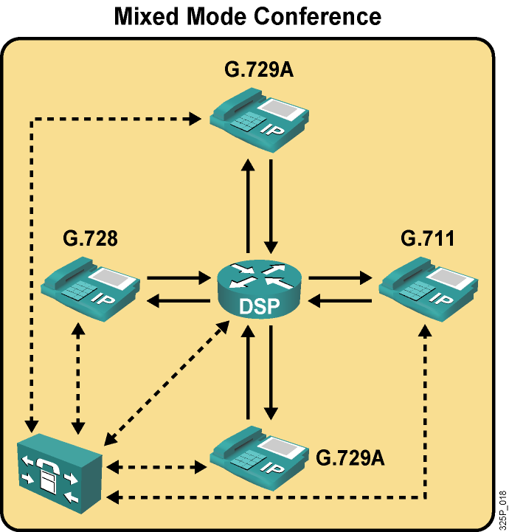
Použitie DSP v konferenčných hovoroch
Konferenčné hovory môžu byť v single alebo mixed režime
  Režim mixed podporuje rôzne kodeky
  Režim single vyžaduje, aby všetci účastníci používali rovnaký kodek
Obvykle v mixed režime je možné na jednom DSP realizovať menej konferenčných hovorov
Notes:
A DSP that is used for mixed-mode conferences allows the conference participants to use different codecs. In this case, the DSP not only mixes streams with the same codec type but can mix streams of different codec types. The DSP also provides transcoding functions. Because of this additional functionality, mixed-mode conferences are more DSP intensive and support fewer conferences than in single mode.
A DSP that is used for single-mode conferences supports only one codec that all conference participants must use. In this case, the DSP can mix streams with the same codec type only. If devices with different codecs join the conference, transcoding is required using separate DSPs.

Slide 34
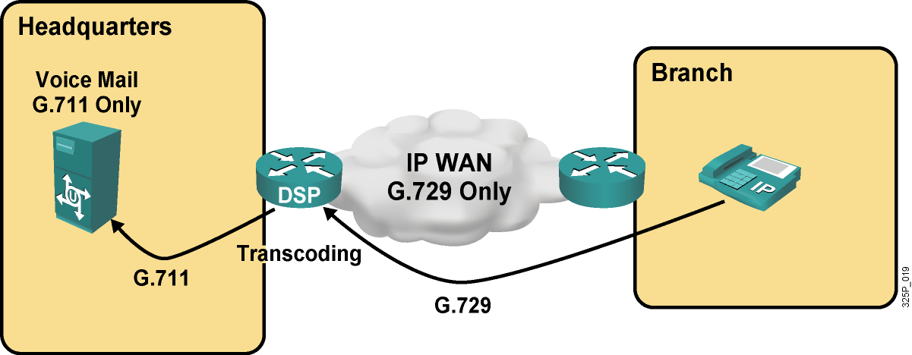
Použitie DSP pre transcoding
Notes:
Transcoding services allow two devices using different codecs to exchange voice information. As seen in the previous example, this can be the case if conference resources support only single-mode conferences but participants use different codecs. Transcoding is the direct digital-to-digital conversion from one (usually lossy) codec to another.
This graphic shows a voice-mail system located in the headquarters of a company. The voice-mail system only uses G.711. The company has a branch office that connects to the headquarters via an IP WAN. To conserve bandwidth, the WAN only permits G.729. If users from the branch access the voice-mail system, they can use only G.729 toward the headquarters, but the voice-mail system requires G.711.
DSPs in the headquarters router provide transcoding services to solve the problem of two different standards. Calls from the branch to the voice-mail system set up a G.729 stream to the transcoding device (headquarters router), which transcodes the received G.729 stream into a G.711 stream toward the voice-mail system.

Slide 35
Paketizácia hlasu

Slide 36
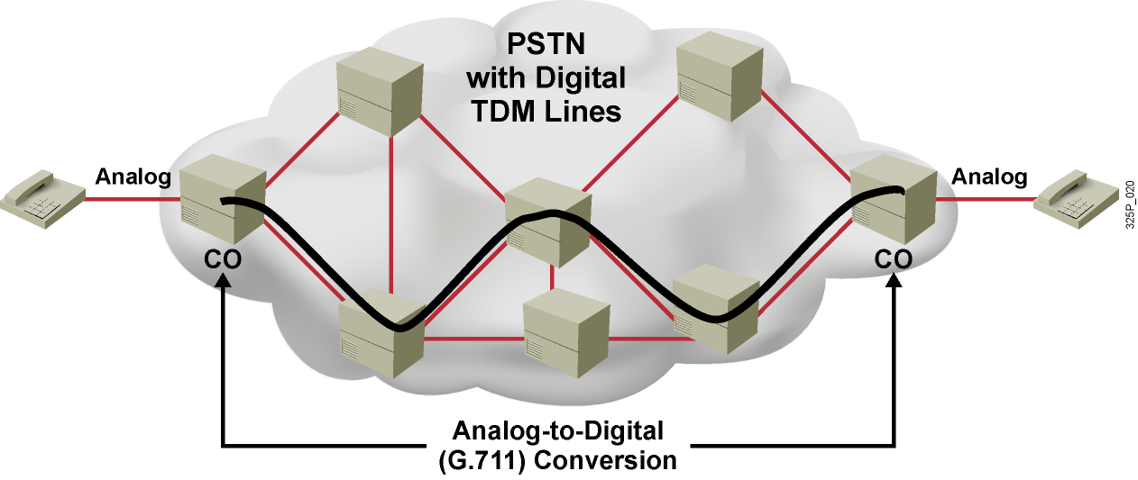
Prenos hlasu v sieťach s prepínaním okruhov
Analógové telefóny sa pripájajú k telefónnym ústredniam
Telefónne ústredne realizujú konverziu medzi analógovým a digitálnym signálom
Po zostavení hovoru sa telefónna sieť stará o to, aby hovor mal
  Svoj vlastný vyhradený prenosový okruh
  Synchrónny prenos s fixnou šírkou pásma a veľmi malým, konštantným oneskorením
Notes:
In PSTN environments, residential telephones connect to central office (CO) switches on analog circuits. The core network is composed of switches that are interconnected by digital trunks, as illustrated in Figure 2.3.1.1. When a caller places a call to a second telephone, the call setup stage occurs first. This sets up an end-to-end dedicated circuit (DS-0) for the call. The CO switch then converts the received analog signals into digital format using the G.711 codec.
During the transmission stage, the synchronous transmission sends G.711 bits at a fixed rate with a very low but constant delay. The circuit dedicates the whole bandwidth (64 kbps) to the call, and because all bits follow the same path, all voice samples stay in order. When the call finishes, switches release the individual DS-0 circuits, making them available for use by other calls.

Slide 37
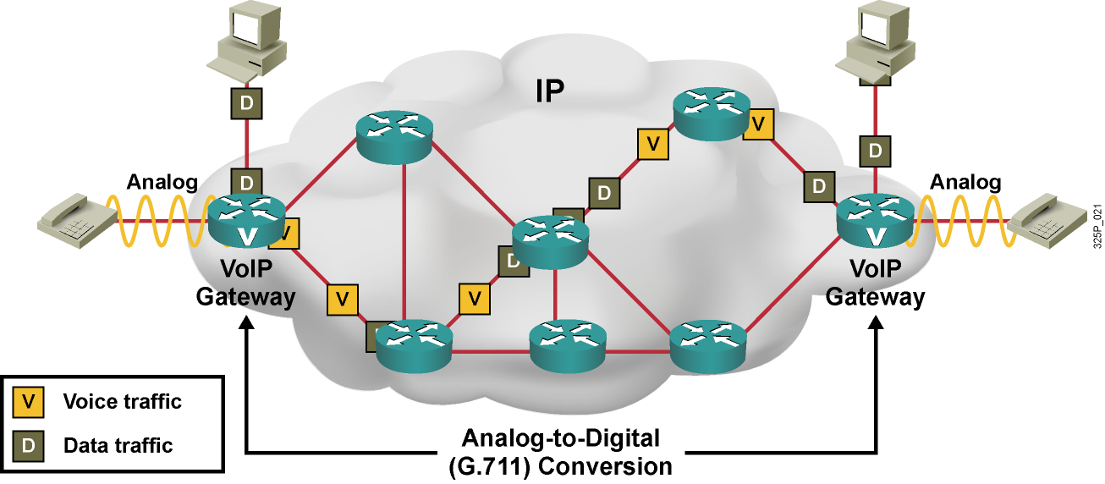
Prenos hlasu vo VoIP sieťach
Analógové telefóny sa pripájajú k hlasovým bránam
Hlasové brány realizujú konverziu medzi analógovým a digitálnym signálom
Po zostavení hovoru IP sieť poskytuje
  Prenos individuálnych paketov sieťou nezávisle
  Zdieľanú šírku pásma, vyššie a premenlivejšie oneskorenie
Notes:
In VoIP networks, analog telephones connect to VoIP gateways through analog interfaces. The gateways connect through an IP network, as shown here. IP phones connect to switches, and the switches in turn connect directly to routers.
When a caller places a call from one telephone to another telephone, the call setup stage sets the call up logically, but no dedicated circuits (lines) are associated with the call. The gateway then converts the received analog signals into digital format using a codec, such as G.711 or G.729 with voice compression.
During the transmission stage, voice gateways insert voice packets into data packets and then send the data packets, one by one, out to the network. The bandwidths of the links between the individual routers are not time‑division multiplexed into separate circuits but are single high-bandwidth circuits, carrying IP packets from several devices. As shown here, data and voice packets share the same path and the same links.

Slide 38
Kolísanie oneskorenia (jitter)
Hlasové pakety do siete vstupujú v pravidelných intervaloch
K príjemcovi však môžu doraziť v inom poradí
a v nepravidelných rozostupoch
Kolísanie oneskorenia (jitter) je miera nerovnomernosti oneskorenia, viditeľná ako premenlivá veľkosť intervalu medzi prichádzajúcimi paketmi
Koncové zariadenie musí byť schopné
  Usporiadať pakety do pôvodného poradia
  Vyrovnať kolísanie v oneskorení
Notes:
Voice packets enter the network at a constant rate (which is lower than the physical line speed, leaving space for other packets). However, the packets may arrive at their destination at varying rates. Each packet encounters different delays on the route to the destination, and packets may even take different routes to the same destination.
At the sending side, packets are sent in a continuous stream with the packets spaced evenly apart. Due to network congestion, improper queuing, or configuration errors, this steady stream can become lumpy, or the delay between each packet can vary instead of remaining constant.
The condition where packets arrive at varying, unpredictable rates is called jitter.
For voice to play back accurately, the destination router has two tasks to complete.
The router must reinsert the correct time intervals
The router must also ensure that packets are in the correct order.

Slide 39
Aký transportný protokol pre VoIP?
Holé IP nemá spoľahlivosť, riadenie toku, detekciu ani korekciu chýb
  Okrem toho, využívať holé IP na transport používateľských dát nie je
  z mnohých dôvodov vhodné
Používateľské dáta sa nad IP prenášajú s využitím transportných protokolov TCP a UDP
Vlastnosti TCP
  Je spoľahlivý, ale hlas ako služba v reálnom čase netoleruje oneskorenia, ktoré do prenosu môžu vniesť retransmisie v TCP
  Réžia TCP je pomerne veľká
Vlastnosti UDP
  Nie je spoľahlivý, čo je pre VoIP výhoda
  Neponúka však prostriedky pre identifikáciu správneho poradia paketov
Je tu potrebný samostatný protokol – RTP
  Real-time Transport Protocol (RTP) postavený nad UDP poskytuje práve tie funkcie, ktoré si prenos real-time dát vyžaduje
Notes:
IP is not well suited to voice transmission. Real-time applications such as voice and video require a guaranteed connection with consistent and predictable delay characteristics. IP does not guarantee reliability, flow control, error detection, or error correction. The result is that packets (or datagrams) can arrive at the destination out of sequence or with errors or not arrive at all.
Two transport layer protocols are available to help overcome the inherent weaknesses of IP. Both TCP and UDP enable the transmission of information between the correct processes (or applications) on host computers. However, only UDP is suitable for VoIP applications.
TCP offers both connection-oriented and reliable transmission. TCP establishes a communications path prior to transmitting data. TCP handles sequencing and error detection to ensure that the destination application receives a reliable stream of data. However, voice is a real-time application. If a voice packet becomes lost, a TCP retransmission triggered by the expiration of a retransmission timer arrives too late for an effective re-transmission of that voice packet. In such a situation, it is better to lose a few packets (which briefly degrades quality) rather than to resend the packet seconds later. When using VoIP, it is more important that packets arrive at the destination application in the correct sequence and with predictable delay characteristics than packets not arriving at all.
The TCP overhead that is needed to provide reliable transport is considerable and must accommodate received packets being acknowledged, sent packets being kept in a retransmission buffer until the receiver acknowledges receipt, and so on. The large TCP header (20 bytes) consumes more bandwidth than the smaller UDP header (8 bytes) does. Also, voice transmission does not need TCP’s retransmission functionality once call setup is complete. UDP, like IP, is a connectionless protocol. UDP routes data to its correct destination port but does not attempt to perform any sequencing or to ensure data reliability.
Real-time Transport Protocol (RTP) and RTP Control Protocol (RTCP) are used instead. RTP is built on UDP. RTP transports the voice packets. RTCP is used with RTP to provide feedback on the link quality. Because UDP and RTP headers are smaller than TCP headers, UDP and RTP headers do not provide reliable transport.
RTP offers a way to reorder packets. In an IP network, packets can arrive in a different order than they were transmitted. Real-time applications must know the relative time of packet transmission. RTP time-stamps packets to provide these benefits:
The packets can be correctly reordered.
The packets can have appropriate delays inserted between packets.

Slide 40
Použiteľné protokoly pre VoIP
Vlastnosť | Potrebné? | TCP | UDP | RTP
Spoľahlivosť | Nie | Áno | Nie✓ | Nie✓
Usporiadanie | Áno | Áno✓ | Nie | Áno✓
Časová synchronizácia | Áno | Nie | Nie | Áno✓
Réžia | Čo najmenšia | Obsahuje nepotrebnú informáciu | Nízka✓ | Nízka✓
Multiplexovanie | Áno | Áno ✓ | Áno✓ | Nie
Notes:
This chart shows the features of the protocol that voice needs and which of those features is offered by each protocol.

Slide 41
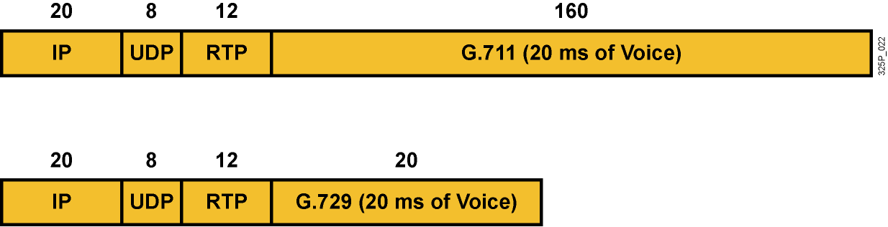
Tvorba hlasových paketov
Digitalizovaný hlas sa postupne zabalí do RTP, UDP a IP
Obvykle sa do paketu vkladá 20ms úsek reči
Notes:
VoIP devices encapsulate voice into RTP and UDP before adding the IP header. The size of the whole VoIP packet depends on the codec that is used and the amount of voice that is packetized. The length of the samples can vary, but for voice, samples representing 20 ms are the maximum duration for the payload. The selection of this payload duration is a compromise between bandwidth requirements and quality. Smaller payloads demand proportionately higher bandwidth per channel band because the header length remains at 40 octets. However, if payloads increase, the overall delay in the system increases, and the system is more susceptible to the loss of individual packets by the network.
This graphic shows voice samples encapsulated in IP packets with UDP and RTP support. Each sample uses a different codec, and is based on a default of 20 ms of voice per packet.
When analog signals are digitized using the G.711 codec, 20 ms of voice consists of 160 samples, with each sample measuring 8 bits. The result is 160 bytes of voice information. These G.711 samples (160 bytes) are encapsulated into an RTP header (12 bytes), a UDP header (8 bytes), and an IP header (20 bytes). Therefore, the whole IP packet carrying UDP, RTP, and the voice payload using G.711 has a size of 200 bytes.
In contrast, 20 ms of voice encoded with the G.729 codec consists of 160 samples, where groups of 10 samples are represented by a 10-bit codeword. The result is 160 bits (20 bytes) of voice information. These G.729 codewords (20 bytes in size) are encapsulated into an RTP header (12 bytes), a UDP header (8 bytes), and an IP header (20 bytes). Therefore, the whole IP packet carrying UDP, RTP, and the voice payload using G.729 has a size of 60 bytes.

Slide 42
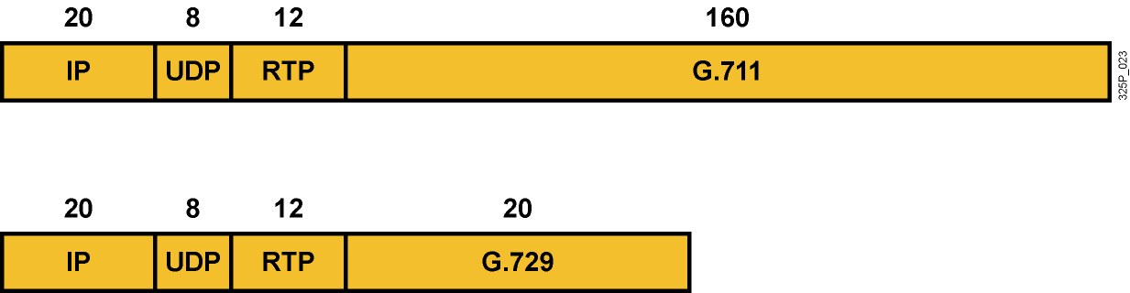
Réžia paketizácie vo VoIP
Hlas sa odosiela ako intenzívny tok malých paketov
Réžia na IP, UDP and RTP hlavičky je veľmi veľká
  Pri G.729 sú hlavičky dvakrát väčšie než samotný hlasový úsek
  Pri G.711 tvoria hlavičky pätinu celého paketu
Nároky na prenos hlavičiek sú 24 kbps pre G.729 a 80 kbps pre G.711, nerátajúc réžiu pre Layer2 rámcovanie
Notes:
The combined overhead of IP, UDP, and RTP headers is enormously high, especially because voice travels in relatively small packets and at high packet rates.
When G.729 is used, the headers are twice the size of the voice payload. The pure voice bandwidth of the G.729 codec (8 kbps) is tripled for the whole IP packet. This total, however, is still not the final bandwidth requirement because Layer 2 overhead must also be included. Without the Layer 2 overhead, a G.729 call requires 24 kbps.
When G.711 is used, the ratio of header to payload is smaller because of the larger voice payload. Headers of 40 bytes are added to 160 bytes of payload, so one-quarter of the G.711 codec bandwidth (64 kbps) must be added. Without Layer 2 overhead, a G.711 call requires 80 kbps.

Slide 43
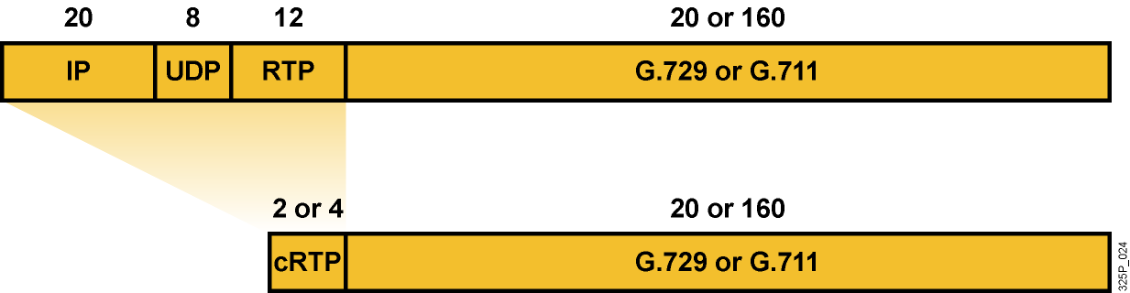
Kompresia RTP hlavičky
RTP kompresia je schopná skomprimovať IP, UDP a RTP hlavičky
zo 40 bajtov na 2 až 4 bajty
  Vychádza z pozorovania, že množstvo položiek v IP, UDP a RTP hlavičke sa nemení a mnohé ďalšie sa menia predpovedateľne
  cRTP vlastne prenáša len informáciu o zmenách variabilných polí v hlavičkách
  Výsledné 4 bajty pri zachovaní kontrolnej sumy v UDP hlavičke
  Výsledné 2 bajty, ak sa kontrolná suma v UDP hlavičke nevyužíva
Je použiteľná len na point-to-point linkách
Jej použitie treba veľmi dobre zvážiť
Notes:
This graphic shows how RTP header compression (cRTP) reduces the huge bandwidth overhead that is caused by the IP, UDP, and RTP headers. The name of this process can be misleading because cRTP not only compresses the RTP header, but it also compresses the IP and UDP headers. Compressing the 40 bytes of combined headers together provides substantially more gain than compressing 12 bytes of RTP header alone because the resulting size is approximately the same (2-4 bytes) in either case.
cRTP is configured on a link-by-link basis. It is possible to use cRTP on just some links within your IP network.
When cRTP is configured (whether on all or some links in the path) a router that receives cRTP packets on one interface and routes the packets out another interface that is also configured for cRTP has to decompress the packet at the first interface and then compress the packet again at the second interface.
cRTP compresses the IP, UDP, and RTP headers from 40 bytes to 2 bytes if the UDP checksum is not conserved (this is the default setting on Cisco devices) and to 4 bytes if the UDP checksum is also transmitted. cRTP is especially beneficial when the RTP payload size is small; for example, with compressed audio payloads between 20 and 50 bytes.

Slide 44
Kedy používať RTP Header Compression
cRTP sa odporúča používať:
  Len na pomalých linkách (menej než 2 Mbps, dokonca sa niekedy uvádza menej než 768 kbps)
  Len ak je potrebné šetriť prenosové pásmo
cRTP má svoje nevýhody:
  Zvyšuje náročnosť spracovania hlasových tokov
  Vnáša dodatočné oneskorenie
  Potenciálne vytvára nové úzke hrdlo na CPU
Ak aj bude cRTP nasadené, je vhodné stanoviť maximálny počet cRTP relácií (štandardne je 16)
Notes:
cRTP reduces overhead for multimedia RTP traffic. The reduction in overhead for multimedia RTP traffic results in a corresponding reduction in delay; cRTP is especially beneficial when the RTP payload size is small, such as audio payloads. Use RTP header compression on any WAN interface where you are concerned about bandwidth and where there is a high proportion of RTP traffic.
Despite the advantages, there are some disadvantages to consider before enabling cRTP. Consider the following factors before enabling cRTP:
Use cRTP when you need to conserve bandwidth on your WAN links, but enable cRTP only on slow links (less than 2 Mbps).
Consider the disadvantages of cRTP:
cRTP adds to processing overhead; check the available resources on your routers before turning on cRTP.
cRTP introduces additional delays because of the time it takes to perform compression and decompression.
Tune cRTP by limiting the number of sessions that are compressed on the interface. The default is 16 sessions. If your router CPU cannot manage 16 sessions, lower the number of cRTP sessions. If the router has enough CPU power and you want to compress more than 16 sessions on a link, set the parameter to a higher value.

Slide 45
Prenosové pásmo na paketizovanú reč

Slide 46
Faktory ovplyvňujúce réžiu na enkapsuláciu
Faktor | Význam
Intenzita toku paketov | Nepriamo úmerná paketizačnému intervalu (interval, počas ktorého sa zhromažďujú vzorky na odoslanie jedným paketom)
Veľkosť paketov | Priamo úmerná paketizačnému intervalu Závisí na kodeku (počet bitov na vzorku)
Réžia na IP (vrátane UDP a RTP) | Závisí na využití cRTP
Réžia linkovej vrstvy | Závisí na konkrétnej technológii
Réžia tunela (ak je použitý) | Závisí na protokole (IPsec, GRE, MPLS)
Notes:
When a VoIP device sends voice over packet networks, the device encapsulates digitized voice information into IP packets. This encapsulation overhead requires extra bandwidth as determined by these elements:
Packet rate: Packet rate specifies the number of packets that are sent in a certain time interval. The packet rate is usually specified in packets per second (pps). Packet rate is the multiplicative inverse of the packetization period. The packetization period is the amount of voice (time) that will be encapsulated per packet and is usually specified in milliseconds.
Packetization size: Packetization size specifies the number of bytes that are needed to represent the voice information that will be encapsulated per packet. Packetization size depends on the packetization period and the bandwidth of the codec that is used.
IP overhead: IP overhead specifies the number of bytes that are added to the voice information during IP encapsulation. When voice is encapsulated into RTP, UDP, and IP, the IP overhead is the sum the overhead of all these headers.
Data-link overhead: Data-link overhead specifies the number of bytes that are added during data-link encapsulation. The data-link overhead depends on the used data-link protocol, which can be different for each link.
Tunneling overhead: Tunneling overhead specifies the number of bytes that are added by any security or tunneling protocol, such as 802.1Q tunneling, IPsec, Generic Route Encapsulation (GRE), or Multiprotocol Label Switching (MPLS). This overhead must be considered on all links between the tunnel source and the tunnel destination.
Because some of these elements come from the same source, the information units that are needed for bandwidth calculation are packetization period or packetization size, codec bandwidth, IP overhead, data-link overhead, and tunneling or security overhead.

Slide 47
Bitová rýchlosť jednotlivých kodekov
Bitová rýchlosť kodekov zohľadňuje len tok čistých hlasových dát
Neuvažuje sa s paketizačnou réžiou
Kodek | Bitová rýchlosť
G.711 | 64 kbps
G.726 r32 | 32 kbps
G.726 r24 | 24 kbps
G.726 r16 | 16 kbps
G.728 | 16 kbps
G.729 | 8 kbps
Notes:
A codec transforms analog signals into digital format. Different codecs have different bandwidth requirements:
G.711: The G.711 codec uses the most bandwidth. It encodes each of the 8000 samples that are taken each second into 8 bits, resulting in a 64-kbps codec bandwidth.
G.722: The G.722 wideband codec splits the input signal into two sub-bands and uses a modified version of adaptive differential pulse code modulation (ADPCM) (including adaptive prediction) for each band. The bandwidth of G.722 is 64, 56, or 48 kbps.
G.726: The G.726 ADPCM coding schemes uses less bandwidth. These coding schemes encode each of the 8000 samples that are taken each second using 4, 3, or 2 bits, resulting in bandwidths of 32, 24, or 16 kbps.
G.728: The G.728 low-delay code excited linear prediction (LDCELP) coding scheme compresses pulse code modulation (PCM) samples using a codebook. Waveshapes of five samples are represented by a 10-bit codeword, which identifies the best matching pattern of the codebook. Because of the compression of five samples (worth 40 bits in PCM) to 10 bits, the bandwidth of LDCELP is 16 kbps.
G.729: The G.729 conjugate structure algebraic code excited linear prediction (CS-ACELP) coding scheme also offers codebook-based compression. Waveshapes of 10 bits are represented by a 10-bit codeword, reducing the bandwidth to 8 kbps.
The bandwidth codec, however, indicates only the bandwidth that is required for the digitized voice itself. It does not include any packetization overhead.

Slide 48
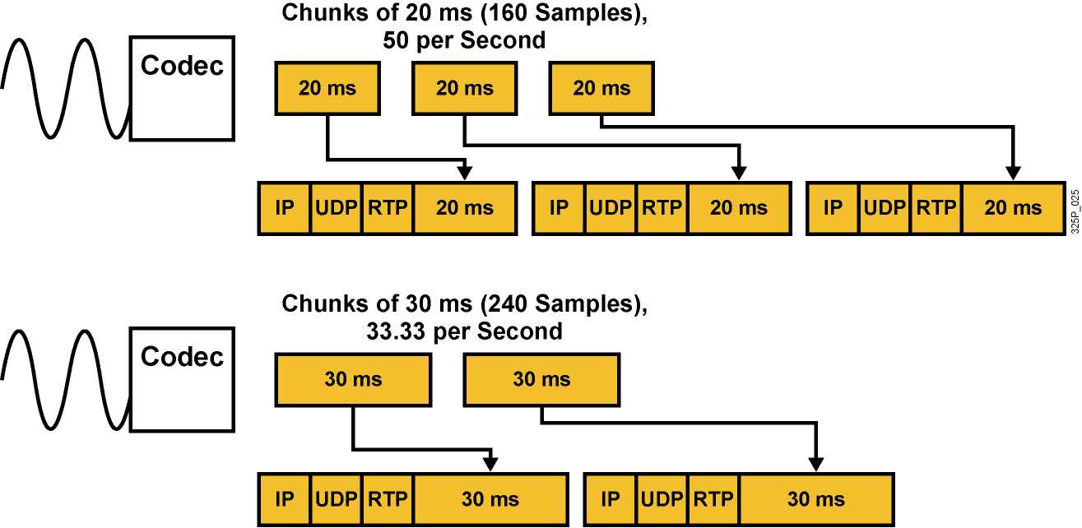
Vplyv paketizačného intervalu na veľkosť paketov a ich množstvo
Veľký paketizačný interval spôsobuje
  Väčšie IP pakety (zväčšuje veľkosť payloadu)
  Nižší počet paketov (znižuje nároky na réžiu)
  Zvýšenie oneskorenia
Notes:
The packetization overhead that a VoIP device adds to the codec bandwidth depends on the size of the added headers and the packet rate. Sending more packets adds more IP, UDP, and RTP headers to the voice payload. The overall VoIP bandwidth requirement includes the whole VoIP packet (headers and voice payload) and the sending rate of the VoIP packets.
On VoIP devices, you can specify, in addition to the codec, the amount of voice encapsulated per packet. Usually, this value is configured by the packetization period (in milliseconds). A higher packetization period results in a larger IP packet size because of the larger payload (the digitized voice samples). However, a higher packetization period results in a lower packet rate, reducing the IP overhead because of the smaller number of packets that must be generated.
This graphic contrasts two scenarios with different packetization periods.
In the first scenario, portions of 20 ms of voice (160 PCM samples) are packetized. The packet rate is the reciprocal of the packetization period. If packetization is done every 20 ms, 50 packets are generated per second. For a total of 60 ms of voice (as shown in Figure 2.4.3.1), three packets, each carrying 20 ms of voice, are needed. Therefore, packetization of this 60 ms of voice introduces an overhead of three IP, UDP, and RTP headers.
In the second scenario, chunks of 30 ms of voice (240 PCM samples) are packetized. This packetization results in a lower packet rate of 33.3 pps. For the 60 ms of voice shown in the figure, only two packets (carrying 30 ms of voice each) are generated, so the IP overhead is reduced by one third compared to the first scenario.
The default value for the packetization period on most Cisco VoIP devices is 20 ms. This default is the optimal value for most scenarios. When you consider increasing this value to benefit from lower IP encapsulation overhead, you also have to consider that a higher packetization period causes a higher delay. The extra delay is introduced during packetization because more voice information has to be collected before a packet can be generated and sent off.

Slide 49
Veľkosť VoIP paketov a intenzita toku
Kodek a paketizačný interval | G.711 20 ms | G.711 30 ms | G.729 20 ms | G.729 40 ms
Bitová rýchlosť (kbps) | 64 | 64 | 8 | 8
Veľkosť payloadu (bajty) | 160 | 240 | 20 | 40
IP réžia (bajty) | 40 | 40 | 40 | 40
Veľkosť VoIP paketu (bajty) | 200 | 280 | 60 | 80
Intenzita toku (pps) | 50 | 33.33 | 50 | 25
Notes:
This table shows examples of VoIP encapsulation with varying codecs and packetization periods.
You can see that an increased packetization period increases the size of the IP packet while reducing the packet rate.
In the table, the IP overhead is assumed to be 40 bytes. This value is the normal value for VoIP packets composed of 20 bytes of IP header, 8 bytes of UDP header, and 12 bytes of RTP header. If cRTP is used, the IP overhead is decreases.

Slide 50
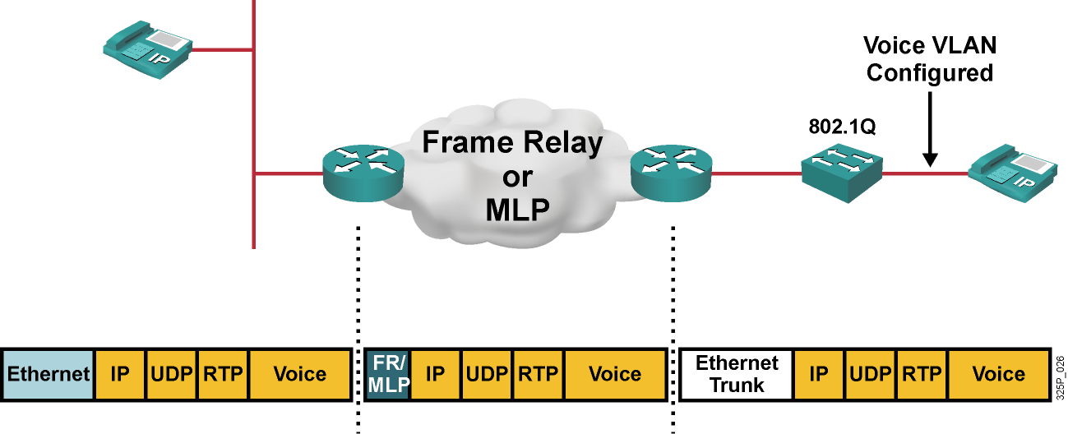
Rozdielna veľkosť Layer2 réžie
Layer2 protokol | Ethernet | Frame Relay | MultiLink PPP | Ethernet Trunk (802.1Q)
Réžia (bajty) | 18 | 6 | 6 | 22
Notes:
When a VoIP device sends IP packets over a link within an IP network, the device encapsulates the packets using the data-link protocol for that link. Each link can use a different data-link protocol.
This graphic illustrates an IP packet that is going from one IP phone to another. The two IP phones are located in different LANs and separated by a Frame Relay network.
Before the sending telephone transmits the VoIP packet onto the LAN, the telephone has to encapsulate the packet into an Ethernet frame.
The router that receives the frame removes the Ethernet header and encapsulates the VoIP packet into Frame Relay before sending the packet out to the WAN.
The router receiving the VoIP packet from the Frame Relay network removes the Frame Relay header and encapsulates the VoIP packet into an Ethernet frame again before passing the packet on to the receiving IP phone.
As illustrated, the Ethernet header and the Frame Relay header differ in size.
The overhead of data-link protocols commonly used for VoIP is 18 bytes for Ethernet, 22 bytes for 802.1Q-tagged Ethernet frames, and 6 bytes for Frame Relay or multilink PPP (MLP).
When you calculate the bandwidth of a VoIP call for a certain link, you must consider the appropriate overhead of the data-link protocol.

Slide 51
Réžia pri tuneloch
Protokol | Veľkosť hlavičky (bajty)
IPsec, transportný režim | 30–53
IPsec, tunelový režim | 50–73
L2TP/GRE | 24
MPLS | 4
PPPoE | 8
Notes:
IPsec and tunneling protocols add headers of different sizes. IPsec overhead depends on the use of the available headers (AH and ESP), the encryption or authentication algorithms that are used in these headers, and the IPsec mode (transport or tunnel mode).
Because AH supports only authentication while ESP supports authentication and encryption, ESP is used more often. With Data Encryption Standard (DES) or Triple DES (3DES) used for encryption and Message Digest 5 (MD5) or Secure Hash Algorithm 1 (SHA-1) used for authentication, the ESP header adds 30 to 37 bytes in transport mode.
When Advanced Encryption Standard (AES) is used as the encryption algorithm and AES-extended cipher block chaining (AES-XCBC) is used for authentication, 38 to 53 bytes are added in transport mode.
ESP DES and 3DES require that the payload is rounded up to multiples of 8 bytes (resulting in 0–7 bytes of padding), while the ESP AES payload is rounded up to multiples of 16 bytes (resulting in 0–15 bytes of padding).
In tunnel mode, an extra 20 bytes must be added for the additional IP header.
L2TP or GRE add 24 bytes to the original PPP frame, MPLS adds 4 bytes to the original IP packet, and PPPoE adds an extra 8-byte PPPoE header between the Ethernet frame and the IP packet.
The table summarizes the various header sizes of these protocols.

Slide 52
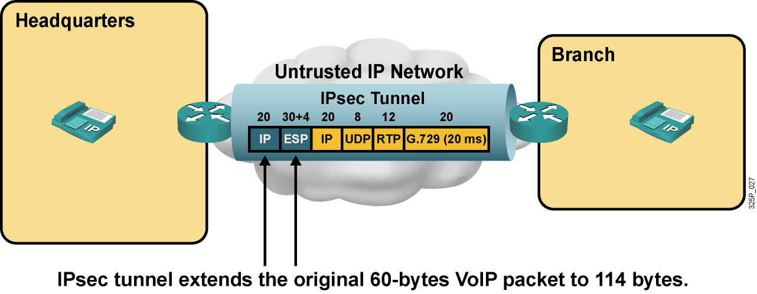
Príklad: VoIP cez IPsec
Kodek G.729 (8 kbps)
Paketizačný interval 20ms
Bez cRTP
IPsec ESP s 3DES a SHA-1, tunelový režim
Notes:
This example shows a company with two sites. The headquarters site is separated from the branch site by an untrusted network. IPsec is used by the routers that connect the sites over the untrusted network. IPsec ESP tunnel mode is used with 3DES encryption and SHA-1 authentication. IP phones that are located at each site use the G.729 codec with a default packetization period of 20 ms. RTP header compression is not enabled.
During a voice call between the headquarters and the branch site, every 20 ms the IP phones encapsulate 20 bytes of digitized voice into RTP, UDP, and IP, resulting in IP packets of 60 bytes. When these VoIP packets are sent out to the untrusted network by the routers, the routers encapsulate each packet into another IP header and protect the packet using an ESP header. This process adds an additional 54 bytes (20 bytes for the extra IP header, 4 bytes of padding to reach a payload size of 64 bytes, and 30 bytes for the ESP header) to the original VoIP packets.
The IPsec packet, which now transports the VoIP packet, has a size of 114 bytes, which is almost twice the size of the original VoIP packet.

Slide 53
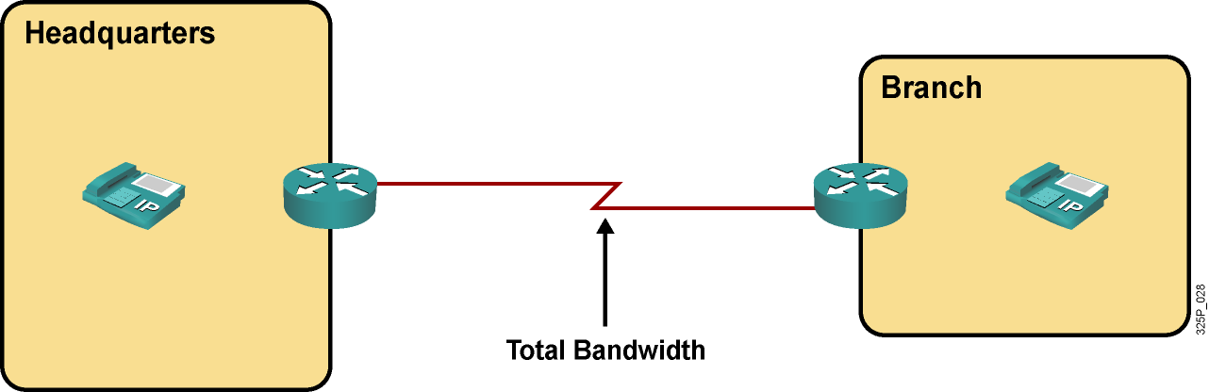
Celkové potrebné pásmo pre VoIP hovor
Celkové pásmo potrebné pre VoIP hovor je potrebné pre:
  Výber primeranej kapacity linky
  Použitie Call Admission Control (CAC)
  Použitie QoS
Notes:
When you are designing networks for VoIP, it is crucial to know the total bandwidth of a VoIP call that takes place across the link. This information is needed to determine the capacity of physical links and to deploy CAC and QoS.
QoS gives priority to voice packets, avoiding high delays that are caused by queuing, which again affects voice quality.
Call Admission Control (CAC) limits the number of concurrent voice calls; this limit avoids oversubscription of the link, which causes quality degradation. CAC mechanisms extend the capabilities of the QoS tool suite to protect voice traffic from being negatively affected by other voice traffic, and to keep excess voice traffic off the network.

Slide 54
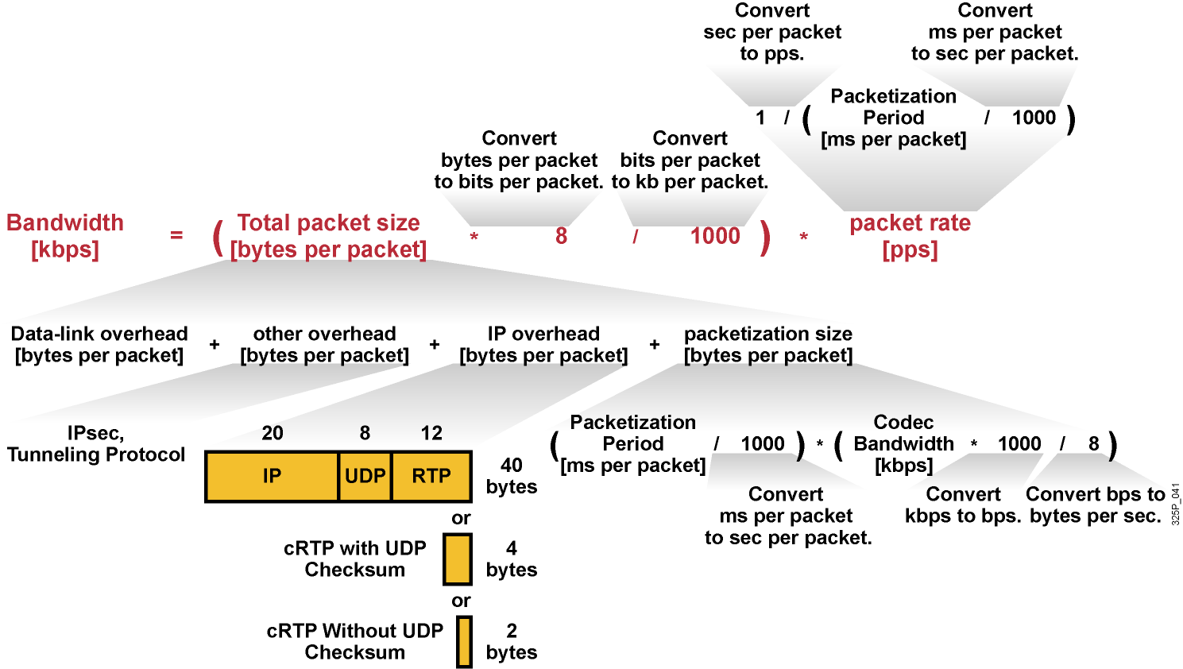
Výpočet pásma pre VoIP hovor
Notes:
Following the steps of the bandwidth calculation procedure, use this formula:
Bandwidth [kbps] = (Total packet size [bytes per packet] * 8 / 1000) * packet rate [pps]

Slide 55
Rýchly výpočet pásma pre VoIP hovor
Parameter | Hodnota
Layer 2 hlavička | 6 až 18 bajtov
IP + UDP + RTP hlavičky | 40 bajtov
Veľkosť hlasovej časti (20-ms sample interval) | 20 bajtov pre G.729, 160 bajtov pre G.711
Bitová rýchlosť kodeku | 8 kbps pre G.729, 64 kbps pre G.711
Príklad: G.729 cez Frame Relay:
Celkové potrebné pásmo = (6 + 40 + 20 bytes) * 8 kbps
————————————— = 26.4 kbps
20 bytes
Notes:
This graphic shows a quick way to calculate the total bandwidth when the packetization size is given. Recall that the ratio of the total bandwidth requirement to the nominal bandwidth for the payload is the same as the ratio of total packet size to payload size.
The payload size depends on the sample interval and the codec that is used and is usually 20 bytes for G.729 and 160 bytes for G.711, assuming a 20-ms sample interval.
The headers are always 40 bytes for the IP, UDP, and RTP headers, plus the Layer 2 header size. The Layer 2 size is 6 bytes for Frame Relay or PPP or 18 bytes for Ethernet.
To calculate the total bandwidth, find the total packet size, including all the headers plus payload and divide by the payload size. Multiply the result by the nominal bandwidth for the codec. The result is the total bandwidth requirement.

